Slide 1

课时练习
模块五 第一章 第三节

Slide 2
一、翻译下列词组。
1. 最流行的电影之一 ___________________________________
2. 关心；照顾 _________________________
3. 变得生气 ___________________________
4. 由于 _______________________________
one of the most popular movies
care for
become angry
because of

Slide 3
一、翻译下列词组。
5. (使)……高兴/振作 ______________________
6. 一开始 ________________________________
7. 表演滑稽的短剧 ________________________
8. 笑脸 __________________________________
cheer … up
at first
perform short funny plays
smiling faces

Slide 4
二、用括号内所给单词的适当形式填空， 每空一词。
1. China imports(进口) seafood ________ (main) from Russia, the US and Norway.
2. Joe’s mother ________ (teach) him that he could do anything, if only he tried hard enough.
mainly
taught

Slide 5
二、用括号内所给单词的适当形式填空， 每空一词。
3. About 36.6% of elderly Chinese people say they feel ________ (alone), according to the China Research Center.
4. The Qinling panda looks tender(温柔的) while the Sichuan one seems more ________ (live).
lonely
lively

Slide 6
二、用括号内所给单词的适当形式填空， 每空一词。
5. The baby was ________ (cry), so I went in to check on him.
crying

Slide 7
三、情景交际。
1. 你在新学校感到孤单，你会在信中这样告诉朋友：
________________________________________.
2. Tom看起来不开心，你想知道他怎么了，可以这样问同桌：
__________________________________________
__________________________________________?
I feel/am lonely in the new school
What’s the matter with Tom/What’s wrong with Tom

Slide 8
三、情景交际。
3. 你想知道对方最喜欢什么类型的音乐，可以这样问：
______________________________ like best?
What kind of music do you

Slide 9
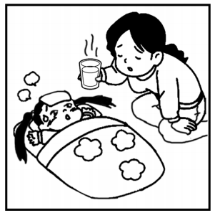
四、看图写话。
1. now, take care of
The woman is taking care of her daughter now.

Slide 10
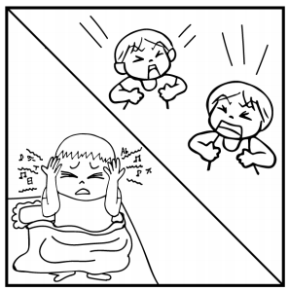
四、看图写话。
2. because of, noisy
The boy/He can’t sleep because of the noisy children.

Slide 11

四、看图写话。
3. teach
Ms. Lin teaches/is teaching the girl (how) to play the violin.

Slide 12
五、熟词生义。
1. invite A. vt. 邀请 B. vt. 招致
______ (1) They invited us to go over to their home and stay for the weekend.
______ (2) Don’t leave the windows open—it’s inviting thieves(小偷).
A
B

Slide 13
五、熟词生义。
2. film A. n. 电影；影片 B. n. 胶片；胶卷
C. n. 薄层；薄膜 D. vt. (把……)拍摄(成)电影、电视
______ (1) There is a film of ice on the river.
______ (2) He put a new film in his camera.
______ (3) I hate people talking while I’m watching a film.
C
B
A

Slide 14
五、熟词生义。
______ (4) She went to Africa to film a wildlife documentary(纪录片).
D

Slide 15


